Slide 1
What is Cloud Native?
...not just tech!
info@container-solutions.com
@michmueller_

Slide 2
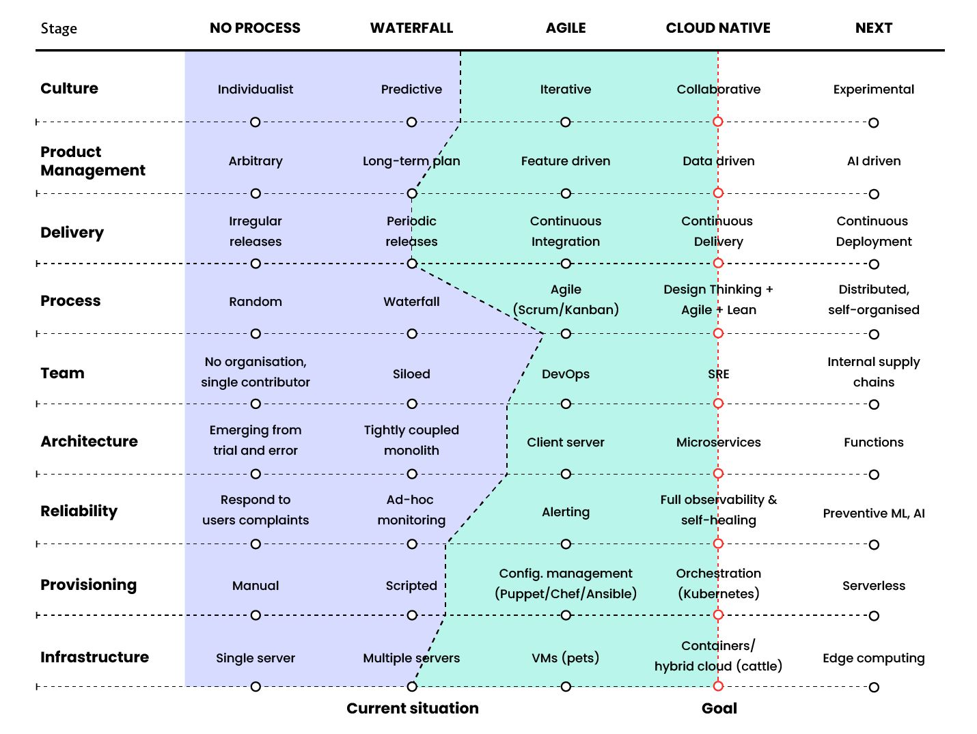
What is Cloud Native
Digital Transformation
Cloud Native Transformation
Agile Transformation
DevOps Transformation
info@container-solutions.com
@michmueller_

Slide 3
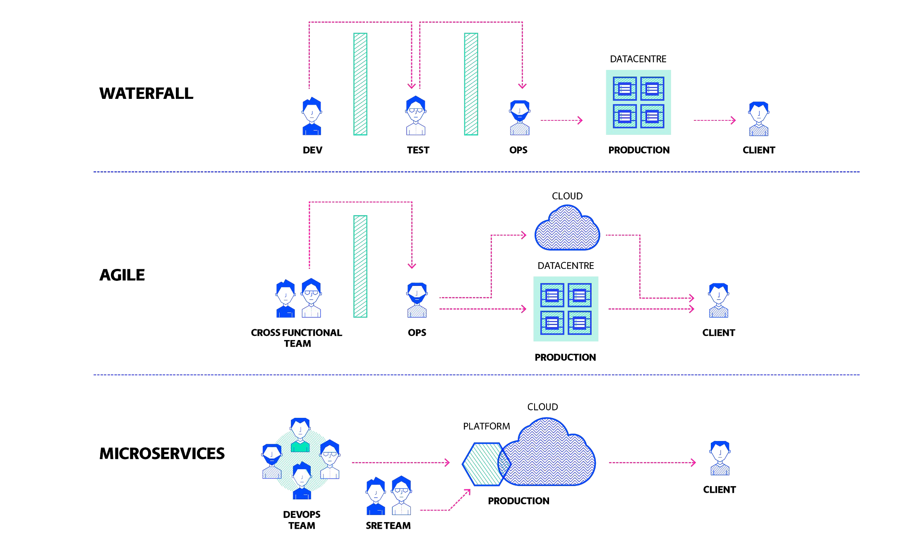

Cloud Native
Platform Engineering
info@container-solutions.com
@michmueller_

Slide 4
What has SRE to do with Cloud Native
SREs operate AND improve systems/applications if they are manageable and well architected.
→ Follow Cloud Native architectural and development practises
SREs apply Software Engineering practises towards operational tasks
info@container-solutions.com
@michmueller_

Slide 5
10 Signs your App is not Cloud Native
Your deployment involves manual steps
An operator needs to decide on which server a new service instance goes
Multiple services must be deployed at the same time to prevent downtime
Your database change requires coordinating
releases of multiple services
Your releases regularly break other consuming services
You can’t replace service instances one-by-one in a rolling manner
One service crashing has a cascading effect and tears down the whole application
You don’t know which request caused the exception in a service down the road
Your application feels slow, but you can’t say which service is the culprit
Your services are too chatty: One user transaction creates hundreds requests
info@container-solutions.com
@michmueller_

Slide 6
How does well architected look like?
Identify Failure Scenarios:
Service A is not able to communicate with
Service B.
Database is not accessible.
Your application is not able to connect to the
file system.
Server is down or not responding.
Inject faults/delays into the services
Avoid Cascading Failure:
When you have service dependencies built inside
your architecture, you need to ensure that one
failed service does not cause ripple effect among the entire chain.
Avoid Single Point if Failure:
Ensure that your services aren’t dependent on one single component.
Handle Failures Gracefully and Allow for Fast Degradation:
If there are errors/exceptions, the service should handle it gracefully by providing an error message or a default value.
Design for Failures:
By following some commonly used design patterns you can make your service self-healing.
info@container-solutions.com
@michmueller_

Slide 7
Origins of SRE
Early 2000s SRE evolved at Google
Independent of the DevOps movement
Happens to embody the philosophies of DevOps
SRE prescribes how to succeed in the various areas
info@container-solutions.com
@michmueller_

Slide 8
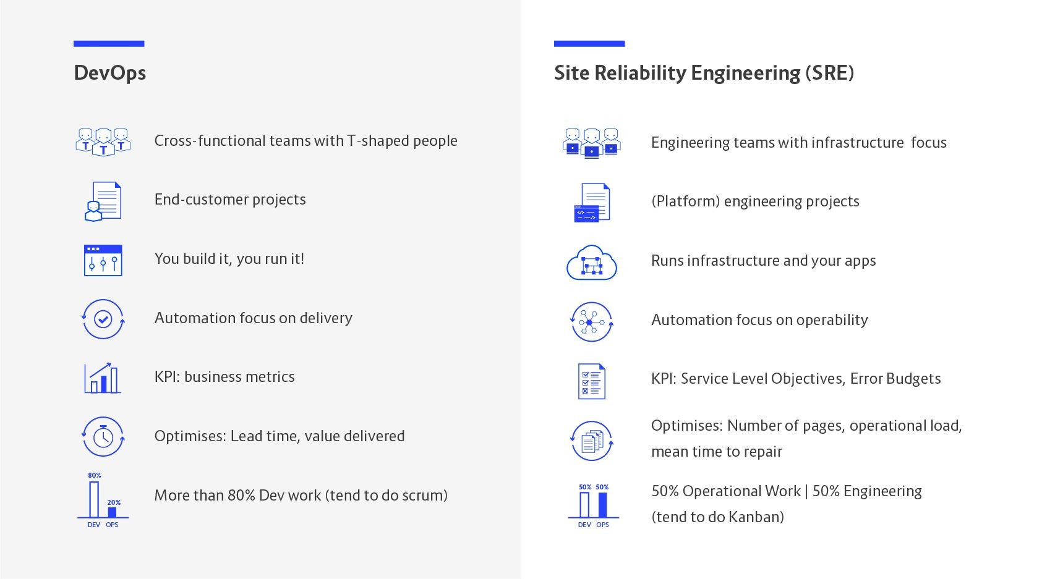
DevOps & Site Reliability Engineering
reliability
info@container-solutions.com
@michmueller_

Slide 9
And why?
Are we going away from DevOps?
info@container-solutions.com
@michmueller_

Slide 10


2-Pizza-DevOps-Teams + 24/7 Ops = ¯\_(ツ)_/¯
info@container-solutions.com
@michmueller_

Slide 11
2-Pizza-DevOps-Teams + 24/7 Ops = ¯\_(ツ)_/¯
say, 5 engineers capable and willing to handle on-call duty
365 days, 2 people on-call (1 primary, 1 backup)
everyone is on duty 146 days a year (almost every 2nd week)!
"DevOps alone can't reasonably operate critical systems 24/7 and deliver features on high quality “
info@container-solutions.com
@michmueller_

Slide 12
What is SRE ?
It’s an approach to IT operations.
SRE teams use the software to manage systems, solve problems, and automate operations tasks.
SRE teams take the tasks that IT operations teams have done, often manually, and instead give them to engineers or ops teams who use tools and automation to solve problems and manage production systems.
It’s a practice while creating scalable and highly reliable software systems.
It helps organizations manage massive infrastructure through code, which is more scalable and sustainable for system admins managing hundreds of thousands of machines.

Slide 13
Regulate the own workload
info@container-solutions.com
@michmueller_

Slide 14
Service Level Agreement (SLA):
What it is:
“A formal contract between a service provider and a customer that specifies the level of service the provider will deliver and the penalties for failing to meet those service levels”
Purpose:
To set customer expectations and provide a framework for accountability.
Example: An SLA might promise 99.9% uptime per month, with service credits provided to the customer if this level isn't met.
Example: A promise to a customer that 99.0% of requests will complete within five milliseconds, with specific penalties if this promise is broken.
Example: A contractual commitment to provide 99.95% uptime, specifying penalties for any breaches.

Slide 15
SLOs
With Consequences
info@container-solutions.com
@michmueller_

Slide 16



Which systems should aspire 100% availability?
info@container-solutions.com
@michmueller_

Slide 17

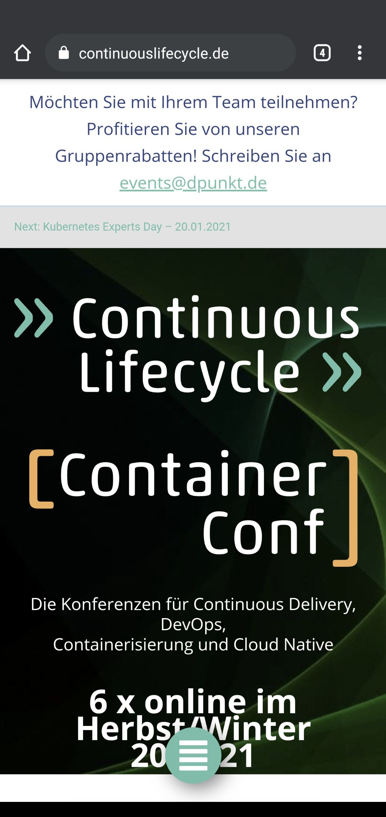
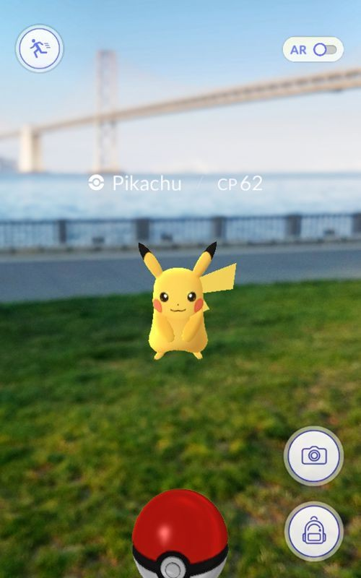
Which probably shouldn’t?
info@container-solutions.com
@michmueller_

Slide 18
Why?
no user can tell the difference between a system being 100% available and, let's say, 99.999% available
-- Ben Treynor, VP of Engineering at Google
info@container-solutions.com
@michmueller_

Slide 19
Service Level Objective (SLO):
What it is:
“An internal, specific target for a service's performance that a team aims to achieve”
Purpose:
To act as a guide for internal teams, ensuring they stay above the SLA commitment and address potential issues before they impact customers.
Example:
An SLO might be set at 99.95% uptime, which is a more ambitious internal goal to give some buffer before violating the 99.9% SLA.
Example: To maintain a 99.5% availability for an online application.
Example: To ensure 99% of videos on a website start playing within two seconds.
Example: To have 99.9% of user requests to an API complete within 100 milliseconds

Slide 20
Service Level Indicator (SLI):
What it is:
“A specific, quantitative measure of a particular aspect of service performance”
Purpose:
To track and monitor actual performance against SLOs.
Example: The actual percentage of uptime, the latency of video playback, or the number of successful transactions.
Example: The actual percentage of database queries that successfully complete in less than 200 milliseconds.
Example: The actual uptime percentage of an online application over a month.
Example: The real number of successful transactions out of total attempts on a retail website.

Slide 21
How they work together:
SLI measures performance: The service is constantly monitored using SLIs (e.g., 99.97% uptime).
SLO sets the target: The internal SLO (e.g., 99.95% uptime) is compared to the SLI.
SLA defines the promise: If the SLI falls below the internal SLO, corrective actions are taken to prevent a breach of the customer-facing SLA. If the SLO is missed and the SLA is also missed, the consequences outlined in the SLA take effect.

Slide 22
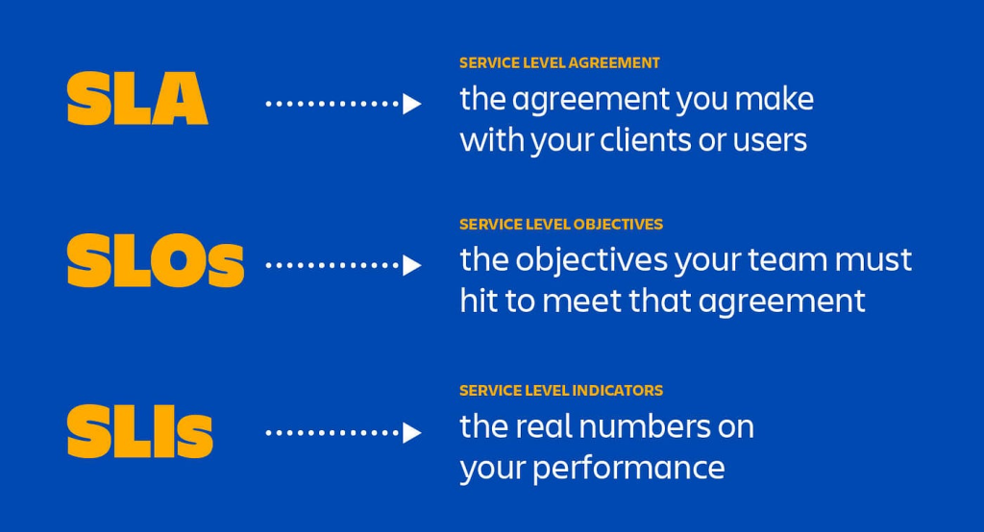

Slide 23
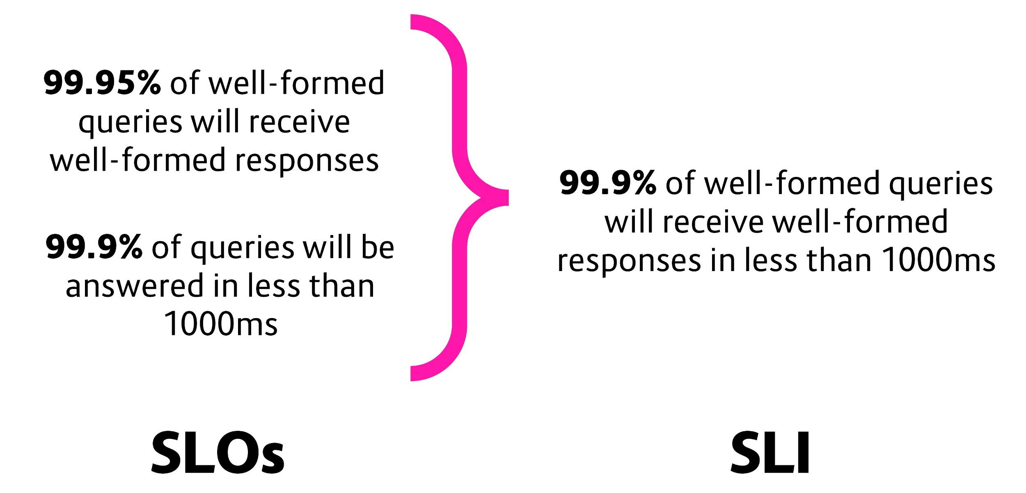
Glossary of terms
SLI
service level indicator:
a well-defined measure of 'good enough or user pains'
SLO
service level objective: a top-line target for fraction of good interactions
specifies goals (SLI + goal)
SLA
service level agreement: consequences
used to specify SLO/SLA
SLA = (SLO + margin)
+ consequences = SLI
+ goal + consequences
Software test / probe
info@container-solutions.com
@michmueller_

Slide 24
SRE incident management best practices

Slide 25
(1) Preparation & Proactive Measures
Define SLIs & SLOs:
Base alerts on Service Level Objectives (SLOs) and user-facing symptoms, not internal system behavior, to ensure accurate and actionable alerts.
Build Resilient Systems:
Design systems for failure with redundancy, implement high-availability, autoscaling to withstand loads.
Automate:
Automate repetitive tasks, configure infrastructure as code, and use automation tools to reduce manual intervention, minimize errors, and accelerate responses.
Practice & Prepare:
Conduct regular practice drills and develop detailed, tested playbooks for common incident scenarios to build team familiarity and trust.
Invest in Observability: Implement comprehensive monitoring with metrics, logs, and traces to gain real-time insights into system behavior and surface potential issues early.

Slide 26
(2) During an Incident
Prioritize & Triage:
Focus on restoring service while also preserving evidence for root cause analysis.
Establish a War Room:
Create a centralized physical or virtual space for real-time collaboration and communication.
Maintain a Living Incident Document:
Use a shared document to record decisions, actions, and a timeline of events as they happen.
Communicate Clearly:
Provide regular, clear updates to stakeholders, using non-technical language, and use status pages for external customers.

Slide 27
(3) Post Incident is over
Conduct Blameless Postmortems:
Identify lessons learned without assigning blame, fostering a culture of open communication and learning.
Document & Track Actions:
Create actionable follow-up items from postmortems, assigning owners and deadlines, and track their completion.
Share Knowledge:
Share lessons learned across the organization and review/update playbooks based on incident learnings to improve future responses.
Integrate Feedback Loops:
Use incident outcomes to drive continuous improvement in systems and processes.

Slide 28
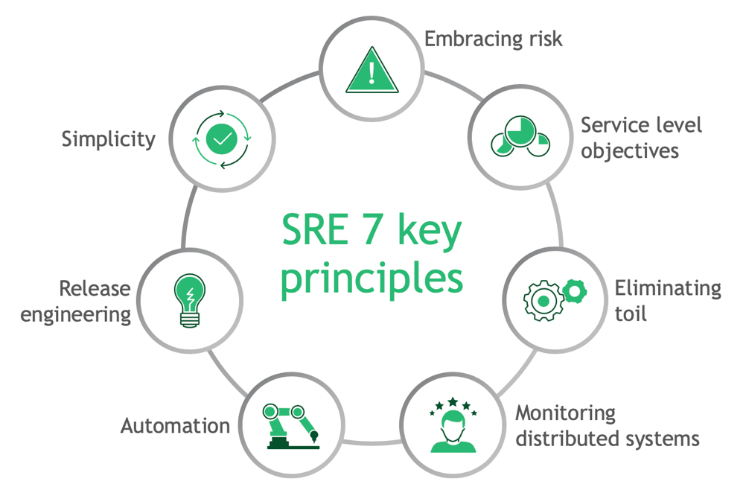

Slide 29
Core SRE Principles
Embrace Risk: Understand that 100% reliability is unattainable and make calculated decisions to balance the costs of increased reliability against the goals of rapid innovation and cost-efficiency.
Service Level Objectives (SLOs): Define measurable goals for service availability and performance that are derived from Service Level Agreements (SLAs).
Error Budgets: A key byproduct of SLOs, this is the amount of unreliability a product can tolerate, allowing for a necessary balance between innovation and stability.
Eliminate Toil: Reduce or eliminate mundane, repetitive, and manual tasks that provide no long-term value through automation.
Monitor Systems: Implement robust monitoring and alerting to track key metrics (the Four Golden Signals: Latency, Traffic, Errors, Saturation) to identify issues before they impact users.
Automation: Automate infrastructure management, deployments, and other operational tasks to improve efficiency, consistency, and reduce the chance of human error.
Release Engineering: Establish processes and standards for the release of new software, ensuring consistency and enabling faster, more reliable deployments.
Simplicity: Focus on building and maintaining simple, understandable systems to make them easier to manage and more reliable

Slide 30
Error Budgets!
An error budget is the amount of error that your service can accumulate over a certain period of time before your users start being unhappy.
The pain tolerance for your users but applied to a particular dimension of your service: availability, latency, and so forth.
To calculate the error budget, we have to use the SLI equation:
SLI = [Good events / Valid events] x 100
Now the percentage is expressed as SLI, and once you define an objective for each of those SLIs, that is your service-level objective (SLO), and the error budget is the remainder, up to 100.
info@container-solutions.com
@michmueller_

Slide 31
For example,
imagine that you’re measuring the availability of your home page. The availability is measured by the number of requests responded with an error, divided by all the valid requests the home page receives, expressed as a percentage.
If you decide that the objective of that availability is 99.9%, the error budget is 0.1%.
You can serve up to 0.1% of errors (preferably a bit less than 0.1%), and users will happily continue using the service.

Slide 32
Why Error Budgets Matter
Error budgets are critical because they provide a way to measure and manage reliability, while still allowing for innovation and new features. By setting an error budget and effectively managing it, teams can ensure that their services are reliable and consistent over time, leading to improved user experiences and better business outcomes.
Increased Reliability: Error budgets help teams to focus on the most critical issues and prioritize their work accordingly Reduced Downtime: With an error budget in place, teams can proactively monitor and track errors, identify and prioritize improvements, and balance innovation with reliability. This can help to reduce downtime.
Improved User Experience: When services are reliable and consistent, users are more likely to have a positive experience. This can lead to increased customer satisfaction and loyalty.
Metrics-Driven Decision Making: By monitoring error budgets and other metrics, teams can quickly identify trends and issues, and make informed decisions about where to focus their efforts.

Slide 33
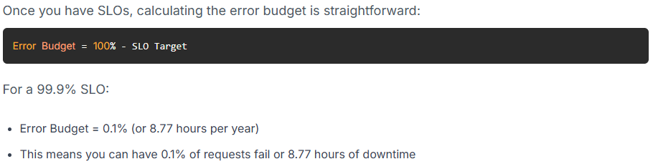
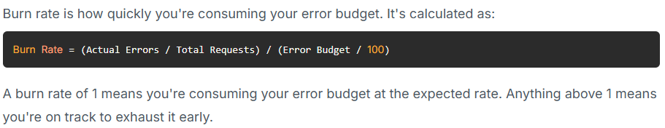
Calculate Your Error Budget
Track Burn Rate

Slide 34
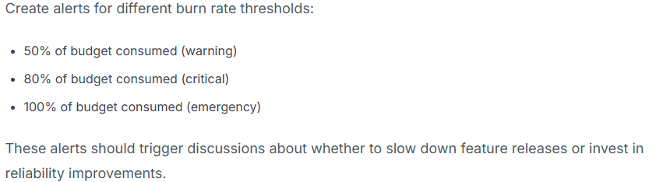

Setup the Alerts
Make Data Driven Decisions

Slide 35
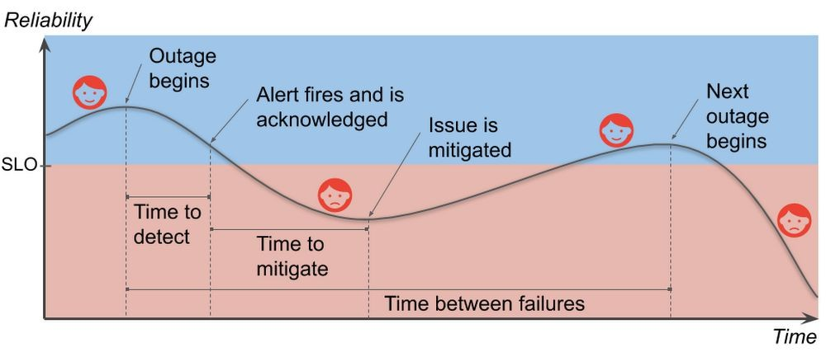
“Nines” cost money and add complexity
Availability Table
Target SLO | Error Budget / 30 days | Requires
99.999 % | 0.43 min (25 sec) | Automated failover
99.99 % | 4.32 min | Automated rollback
99.95 % | 21.6 min | Automated rollback
99.9 % | 43.2 min | Comprehensive monitoring, 24/7 on-call
99.5% | 216 min | Comprehensive monitoring, 24/7 on-call
99 % | 432 min | Alerting via user complaints
Image credit: Google
info@container-solutions.com
@michmueller_

Slide 36
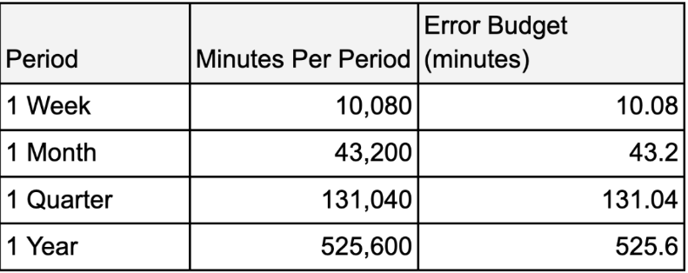
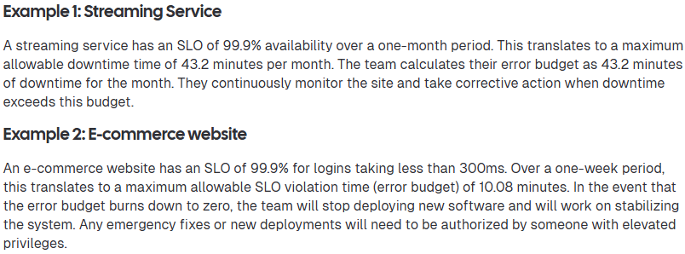

Slide 37
Monitoring and Alerting aligned with SRE
Monitoring and alerting aligned with SRE involves using Service Level Indicators (SLIs) and "Service Level Objectives" (SLOs) to track key metrics like latency, error rate, traffic, and saturation (the "Golden Signals") to ensure reliability.
Alerts are triggered when these metrics violate SLOs, enabling quick detection and resolution of issues before users are impacted, while also providing insights for long-term performance planning

Slide 38
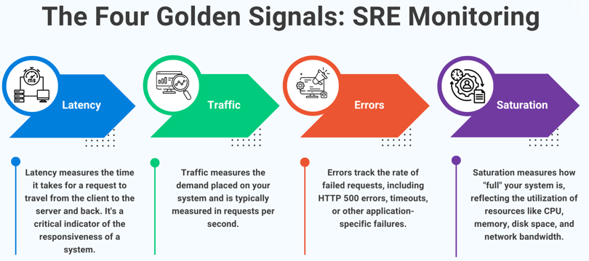

Slide 39
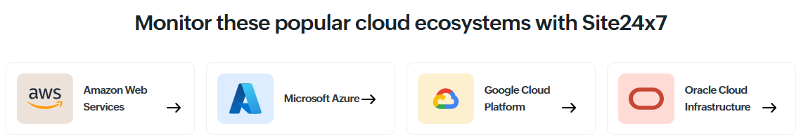
Open Link: https://www.site24x7.com/ads/cloud-monitoring.html?ad_src=google_cloud_monitoring_in&ad_grp=cloud_monitoring&network=g&device=c&keyword=cloud%20infrastructure%20monitoring&campaignid=11483605405&creative=627885353930&matchtype=p&adposition=&placement=&adgroup=112532945455&targetid=kwd-57623829834&location=9198125&gad_source=1&gad_campaignid=11483605405&gbraid=0AAAAAChAObtHRMG6EvHiTSYpboSw_Rg9g&gclid=Cj0KCQjw0Y3HBhCxARIsAN7931XAagAsdytv3xC-Akp7YcYpZ_m83kkEXKyuAoCtNQNTD-mfcNyZ13oaAl8dEALw_wcB

Slide 40
Symptom-Based Alerting
Rather than alerting on internal causes, SREs alert on symptoms that indicate a problem is affecting users, allowing for faster response before users are significantly impacted.

Slide 41
How it Works
Define SLIs and SLOs: SREs work with product teams to define acceptable performance levels for key SLIs.
Implement Monitoring: Tools are used to collect metrics, logs, and traces to provide insights into the system.
Set Up Alerts: Alerts are configured to trigger when SLIs approach or breach SLOs, focusing on user-impacting issues.
Use Dashboards for Visibility: Dashboards offer real-time overviews of system health, helping SREs and other teams understand the current state of the system.
Respond and Diagnose: Alerts direct SREs to potential problems, which they then investigate using the data from dashboards, logs, and traces to find the root cause and restore service.

